Slide 1


GREEN CODE
TO ACHIEVE ZERO WASTE DISCHARGE FROM
OUR COLLEGE
Group Members~
Suhani Jain
Karan Prajapat
Shivam Bhatnagar
Vaishali Raghuwanshi

Slide 2

PROBLEM STATEMENT SSTATEMENT
The challenges is to devlop innovative and practical solutions to adress the growing waste production on college campus which is primarily caused by wrappers, cold drinks and waste genrated by college canteen .

Slide 3

OBJECTIVE
ZERO WASTE DISCHARGE
To achieve zero waste discharge in our institute we have made this project in which we have prepared natural products from different types of waste generated in our campus.

Slide 4



PRODUCTS FORMED FROM DIFFRENT TYPES OF WASTE
Hand Wash
Brown Coal
Green Scrub
Herbal Chalk
Dish Wash Powder
DRY LEAF WASTE
PAPER WASTE
White Coal
PLASTIC WASTE
Eco Bricks
CANTEEN WASTE
Plant Health Promoter

Slide 5
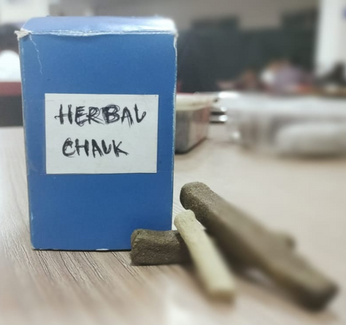
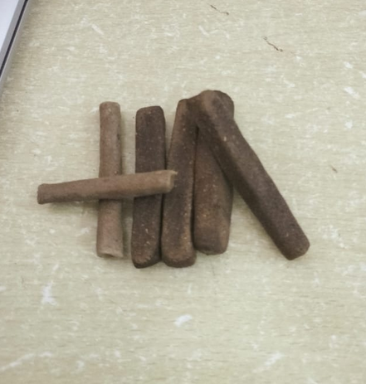
HERBAL CHALK
Herbal chalk is a very first chalk made from waste dry leaves.
It does not contain any chemicals.
Non-toxic in nature.
It is dustless, free from calcium carbonate and carbonate.

Slide 6
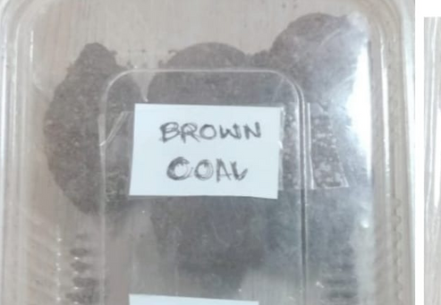
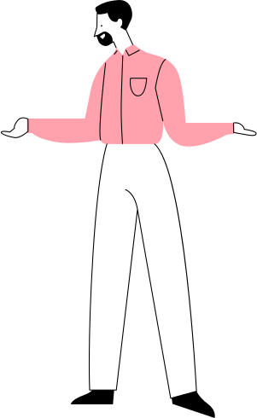

BROWN COAL
Brown coal is an organic mass which is a biofuel made from waste dry leaves of college.
It has calorific value of 3800-4000 kcal/kg.

Slide 7
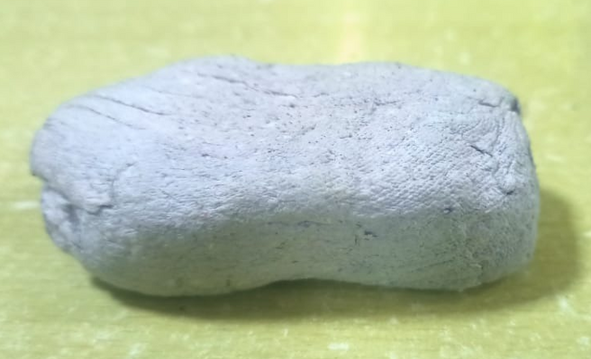

WHITE COAL
We used papers which is waste for college
and converted it into white coal which is a
source of energy.
White coal is a paper mass used in paper mills to create recycled paper.
They work well in cooking as they are slow burning steady heat source.

Slide 8
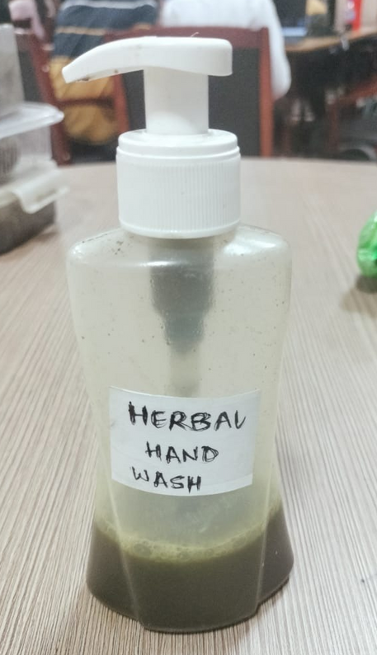
HERBAL HAND WASH
Herbal handwash is a product made from waste dry leaves.
It is cheap and antibacterial.

Slide 9
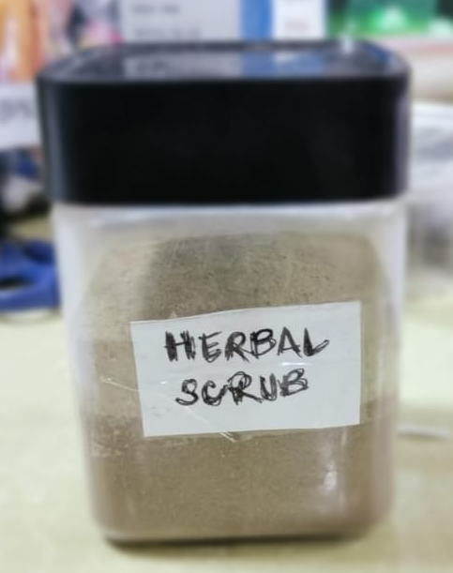
GREEN SCRUB
Green scrub is a product made from waste dry leaves of our campus.
It is herbal and actibacterial.

Slide 10
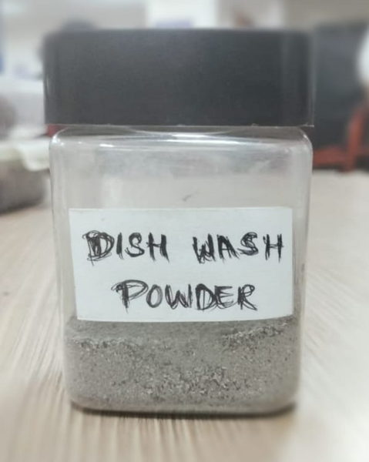
DISH WASH POWDER
This powder has a great ability to cleans dishes and utensils as this is made from the ash of waste dry leaves found in college campus.
Non toxic and safe for use by people.
It is environment friendly and sustainable.

Slide 11

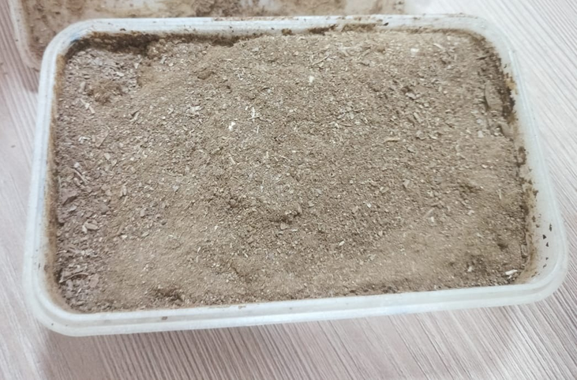
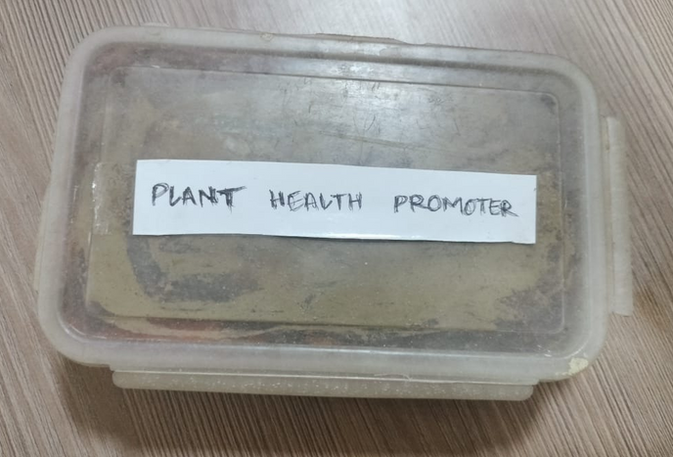
PLANT HEALTH PROMOTER
Plant health promoter is a mixture made from vegetable
waste and dry leaves which will provide
good health to plants.

Slide 12
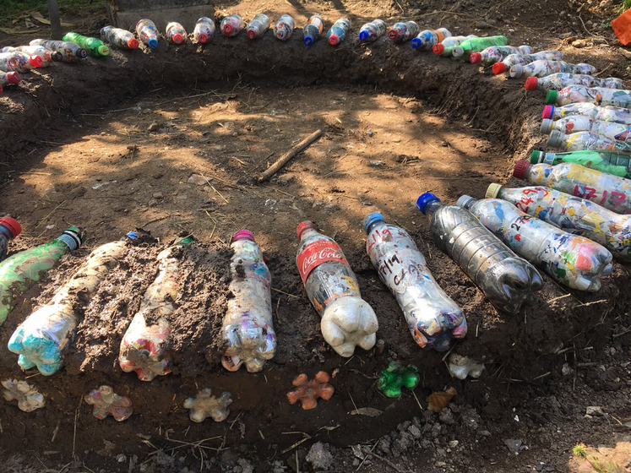
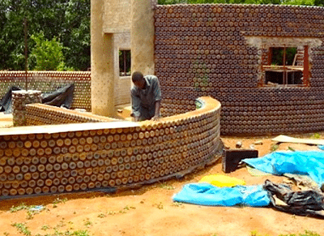
ECO BRICKS
Plastic is a big problem nowadays and it takes more than 4000 years to decompose so here we are using our college plastic bottles and wrappers to use it as a eco brick.

Slide 13
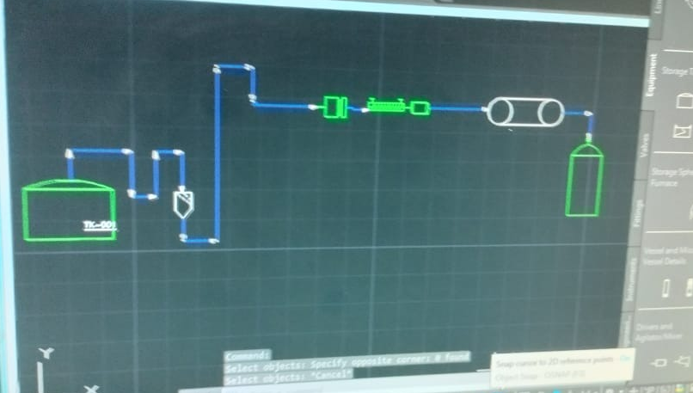
P & ID For Brown Coal

Slide 14

E-COMMERCE WEBSITE FOR OUR PRODUCTS
Green code website is designed for selling products which
is prepared from different types of waste found in college
campus.

Slide 15
THANK YOU

